Slide 1

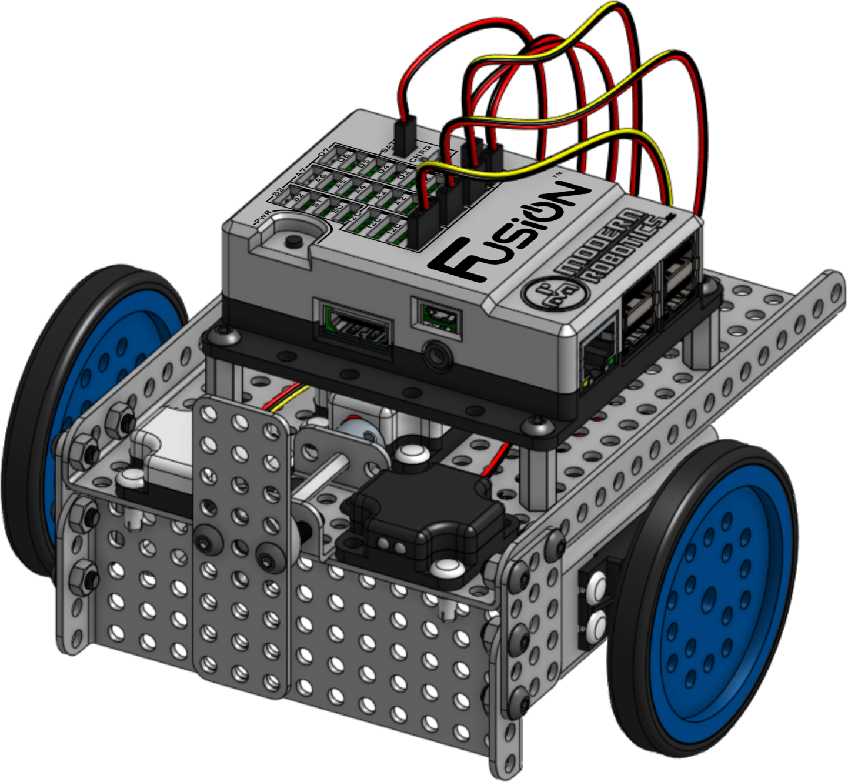

Base Bot
Building Instructions
Version 1.0.0
Modern Robotics, Inc.

Slide 2
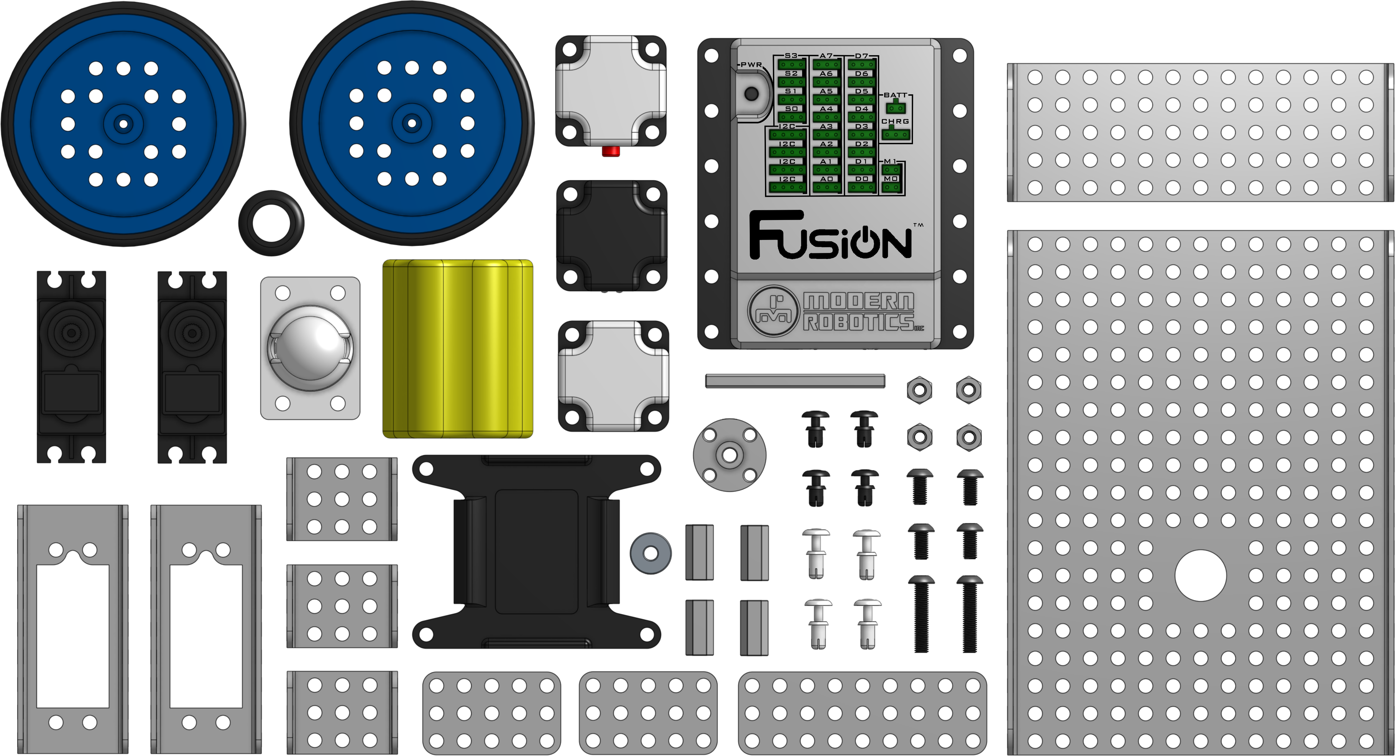
This document is published by Modern Robotics, Inc. No part of this document may be copied, published in print or shared online or otherwise publicly released without the express written consent of Modern Robotics, Inc.
Specifications subject to change without notice.

Slide 3
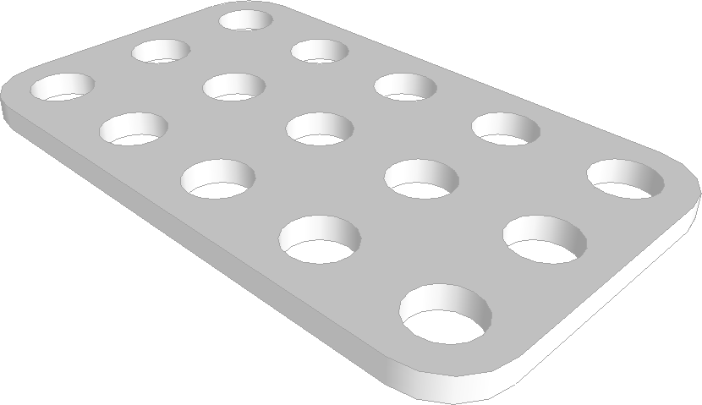
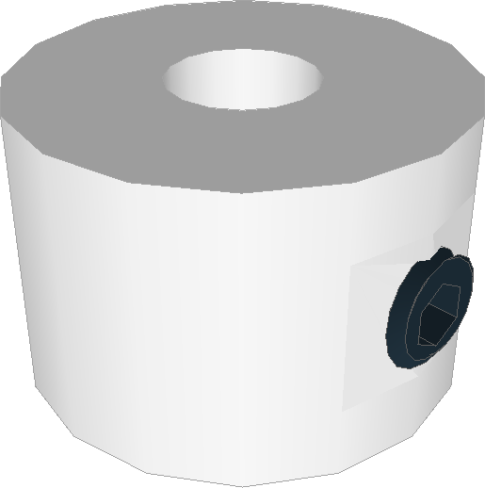
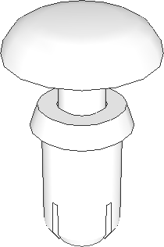
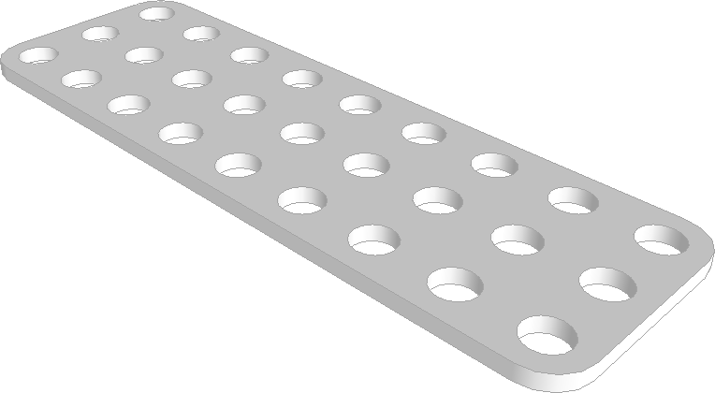
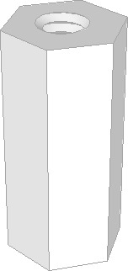
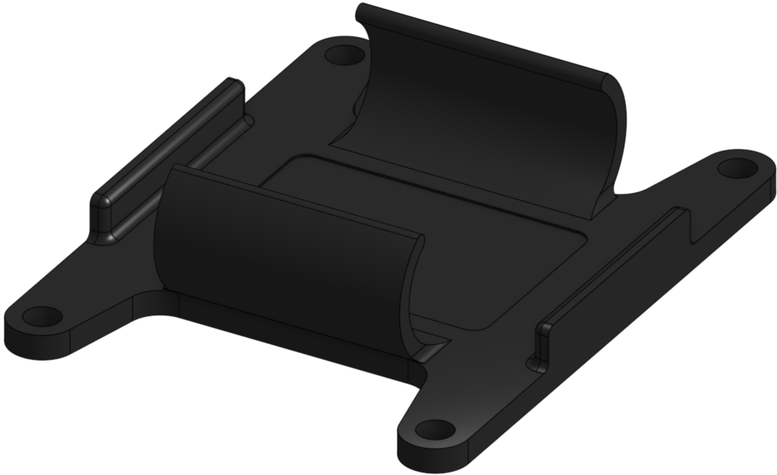
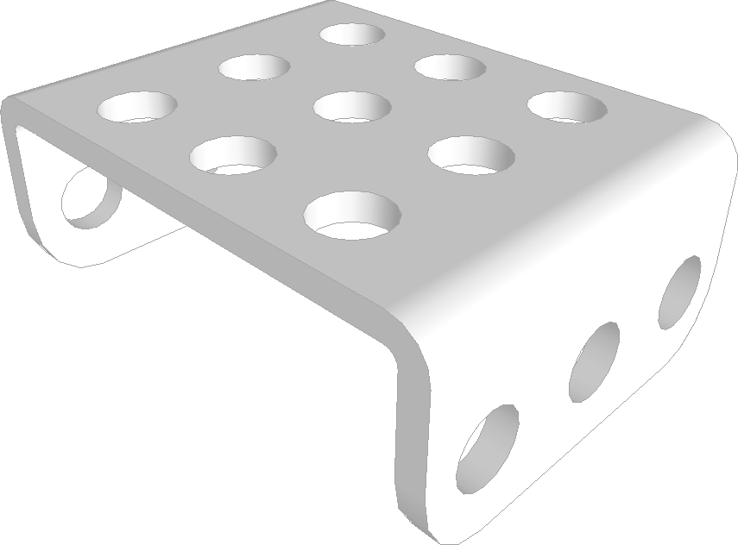
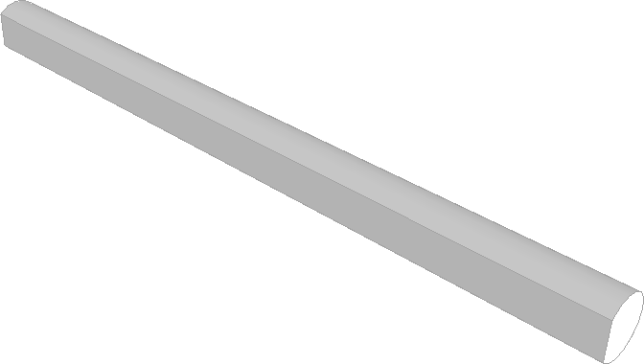
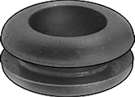
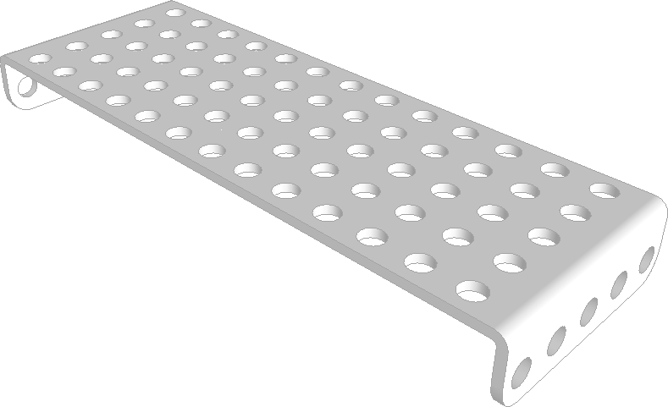
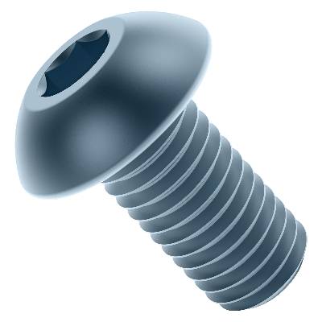
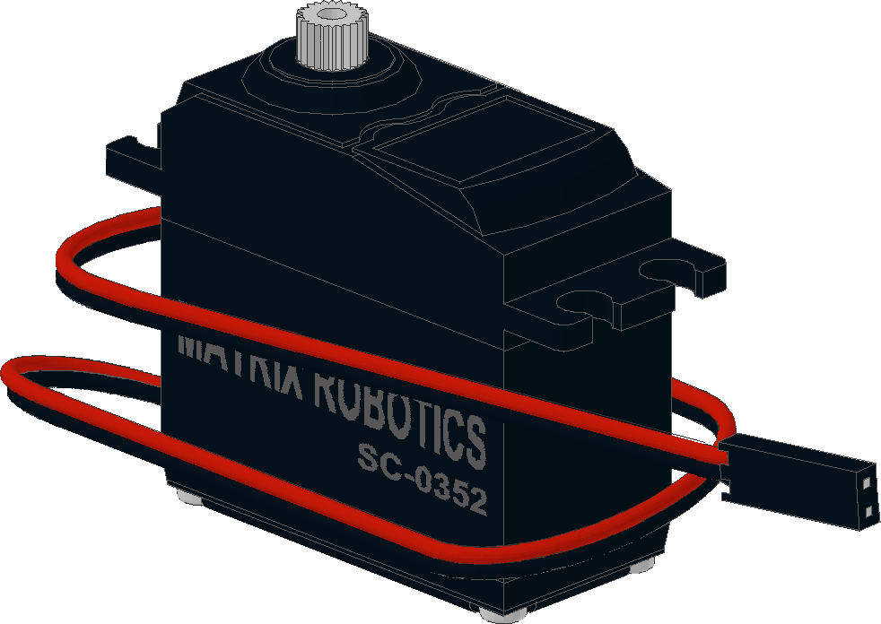
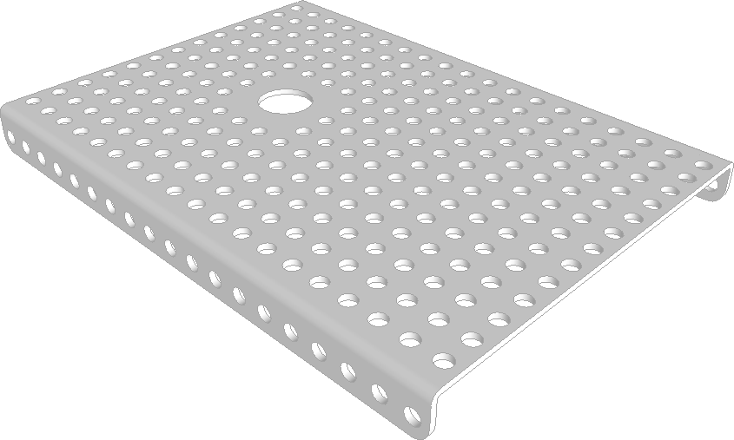
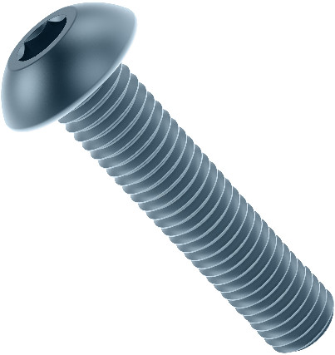
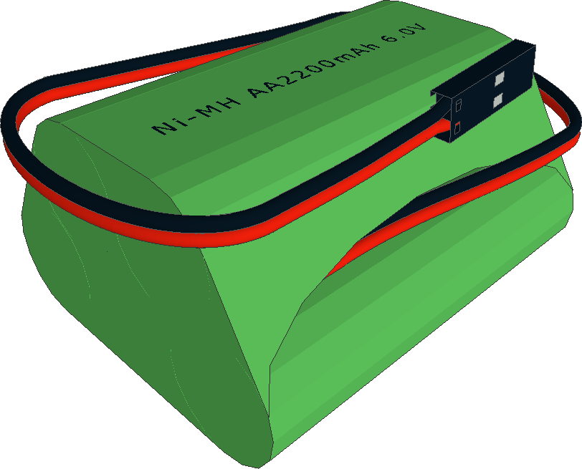
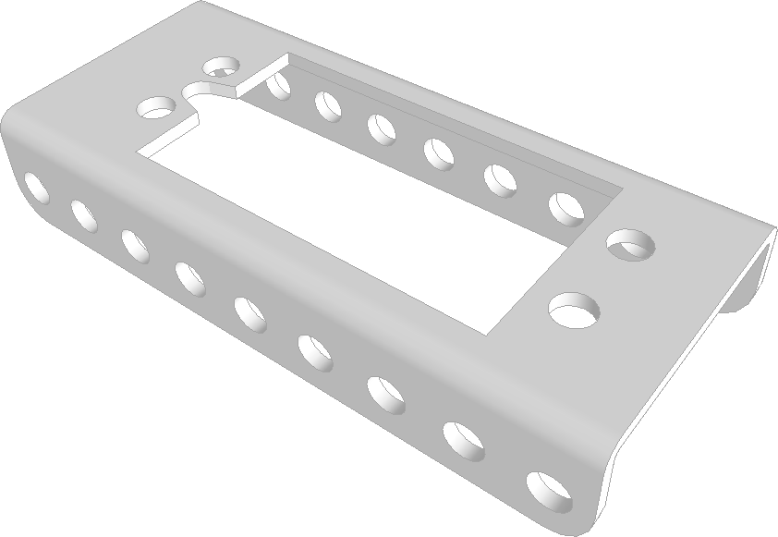
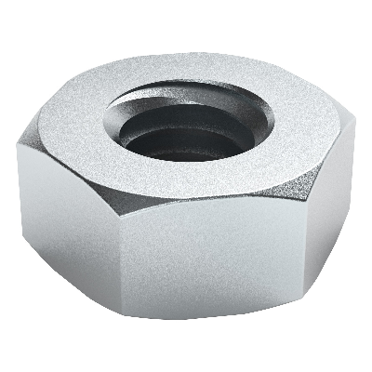
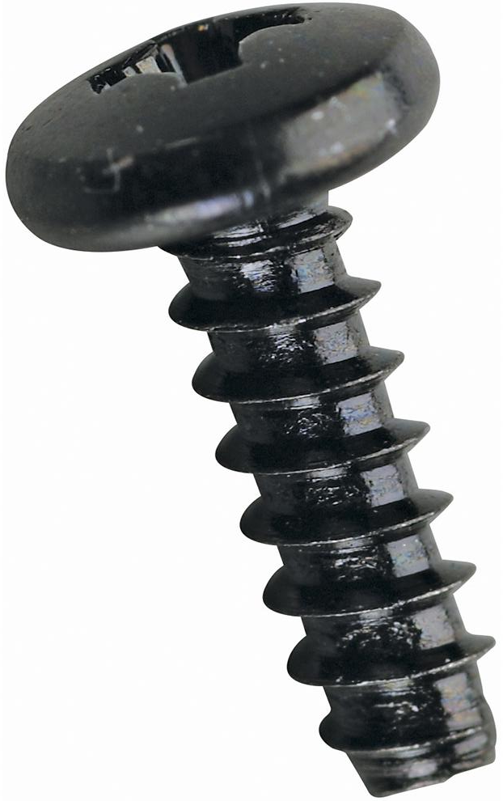
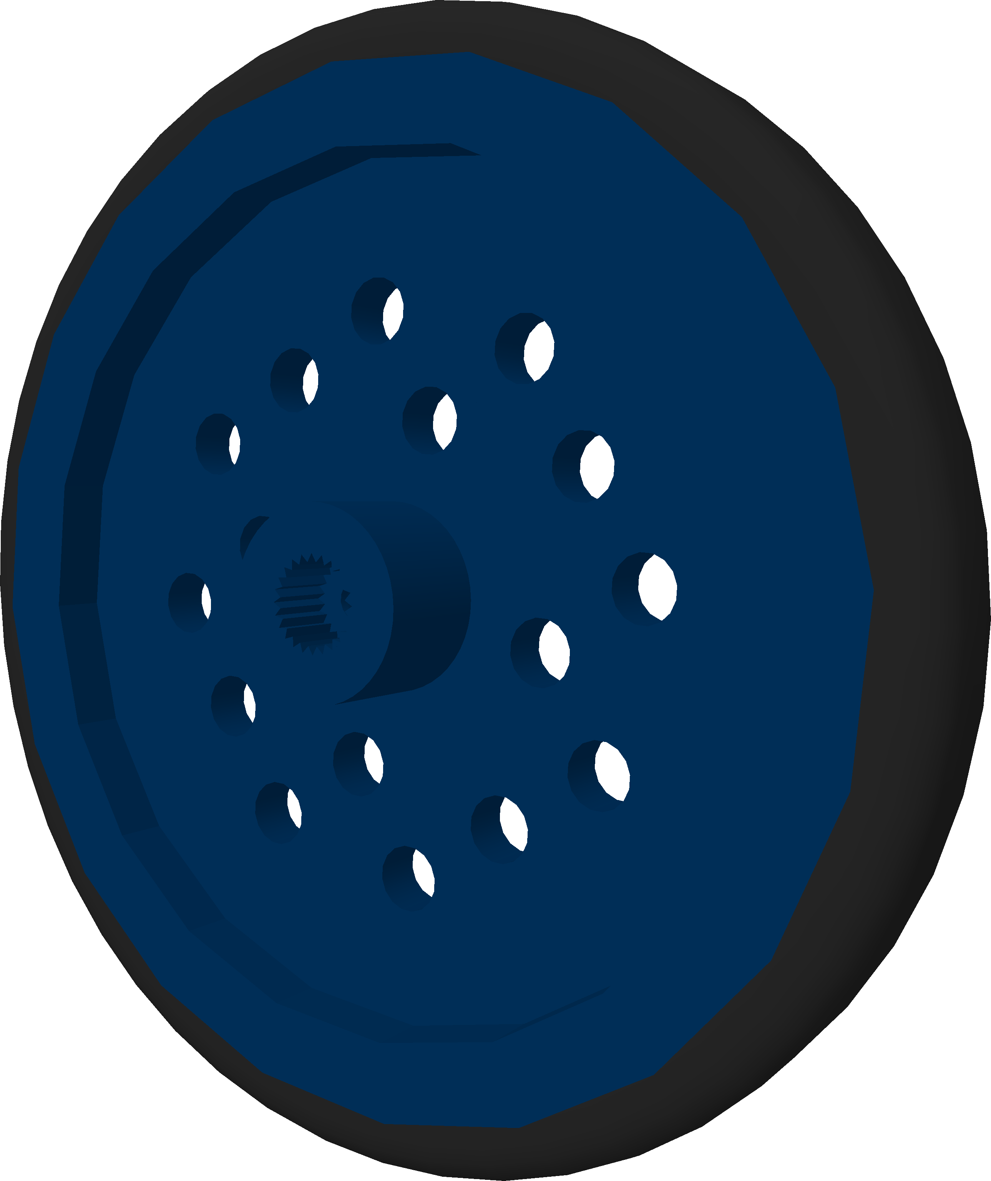
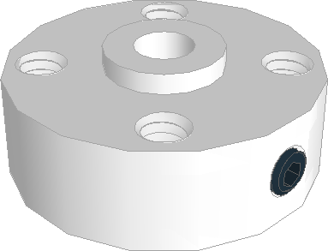
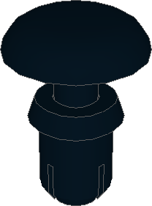
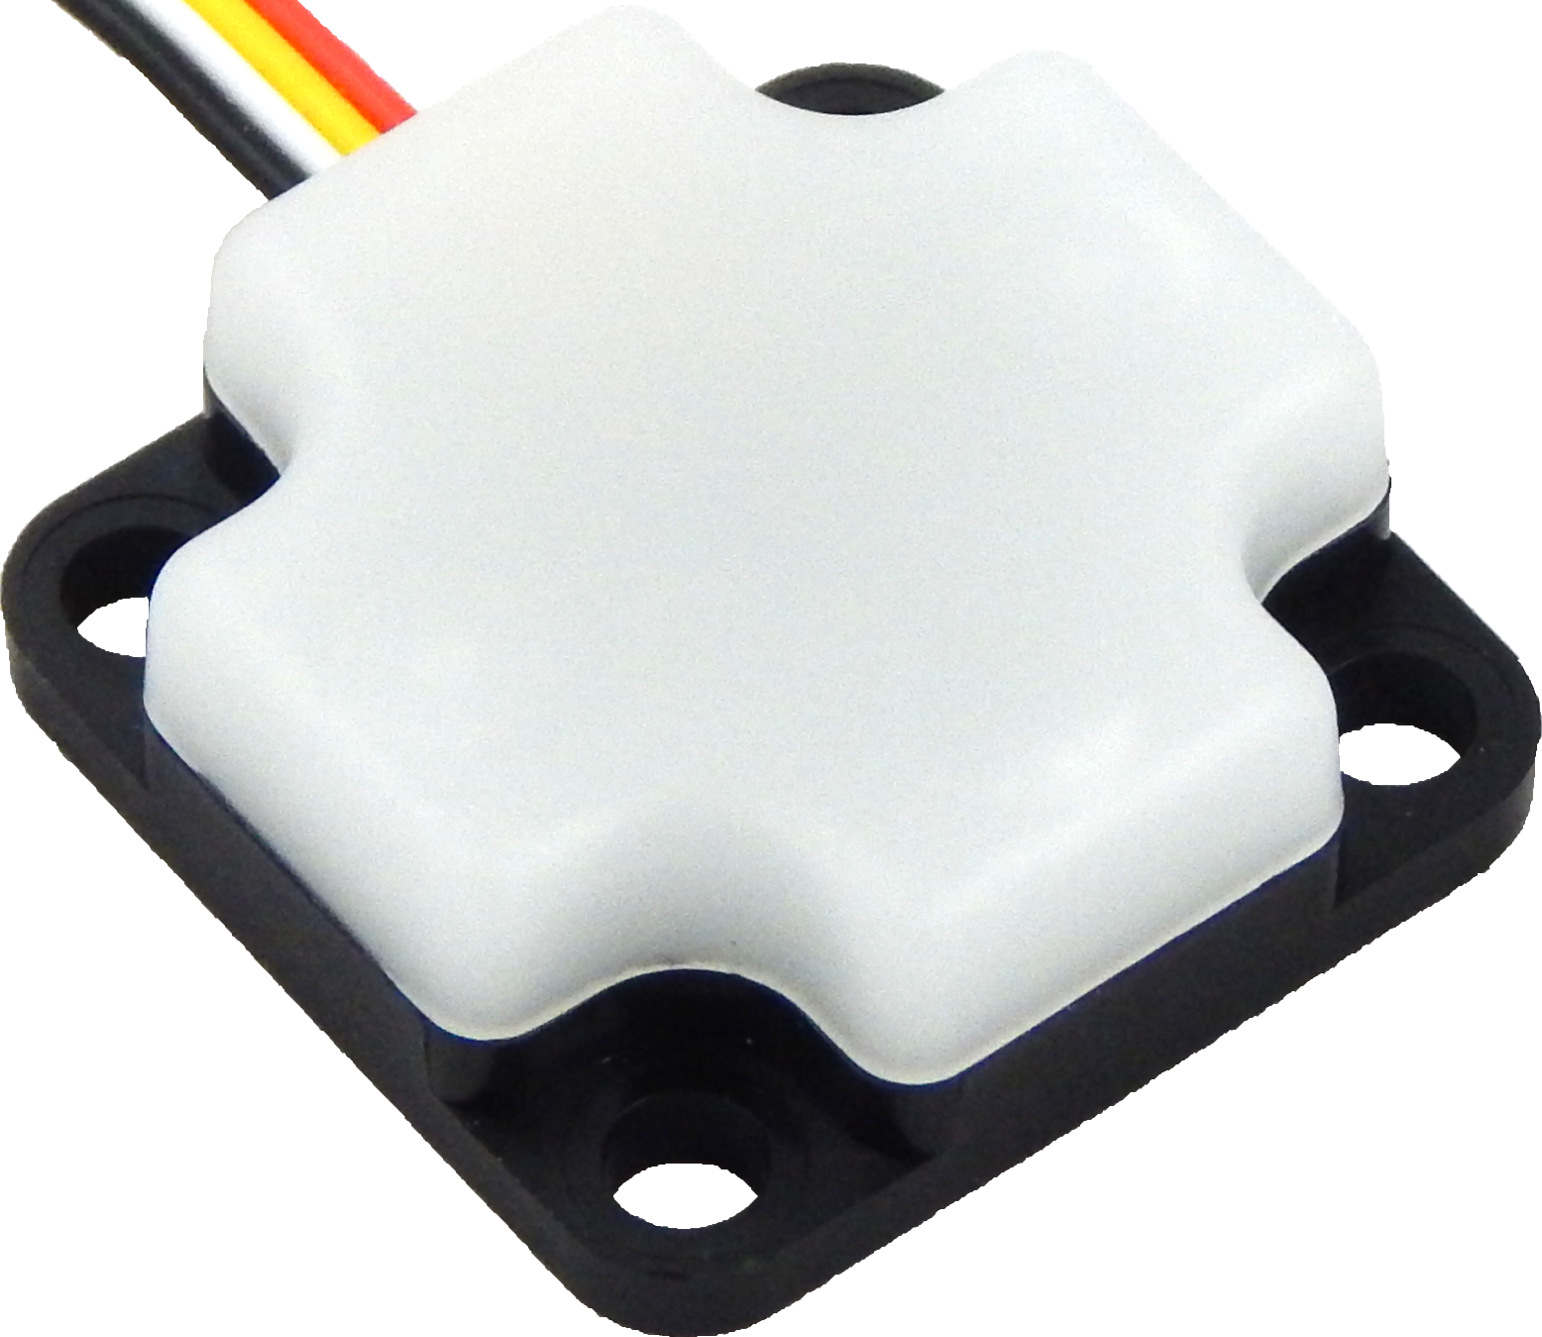
Bill of Materials
x2 04-0305 3x5 Gusset Plate | x1 08-0019 Axle Collar | x14 11-6002 Quick Connect Medium
x1 04-0309 3x9 Gusset Plate | x4 09-0003 16mm Standoffs | x1 45-0300 Battery Pack Mount
x3 05-0303 3x3 Flanged Plate | x1 10-0052 52mm D-Shaft | x1 45-1007 Push-In Grommet
x1 05-0513 5x13 Flanged Plate | x32 11-4108 M4 x 8mm Screw | x2 45-1010 DC Motor
x1 06-1319 13x19 Flanged Plate | x2 11-4120 M4 x 20mm Screw | x1 45-1300 6V Battery Pack
x2 07-0008 Servo/Motor Plate | x24 11-4501 M4 Hex Nut | x2 45-1400 Wheel
x1 08-0007 Axle Hub | x2 11-6001 Quick Connect Short | x1 45-2005 Integrating Gyro

Slide 4
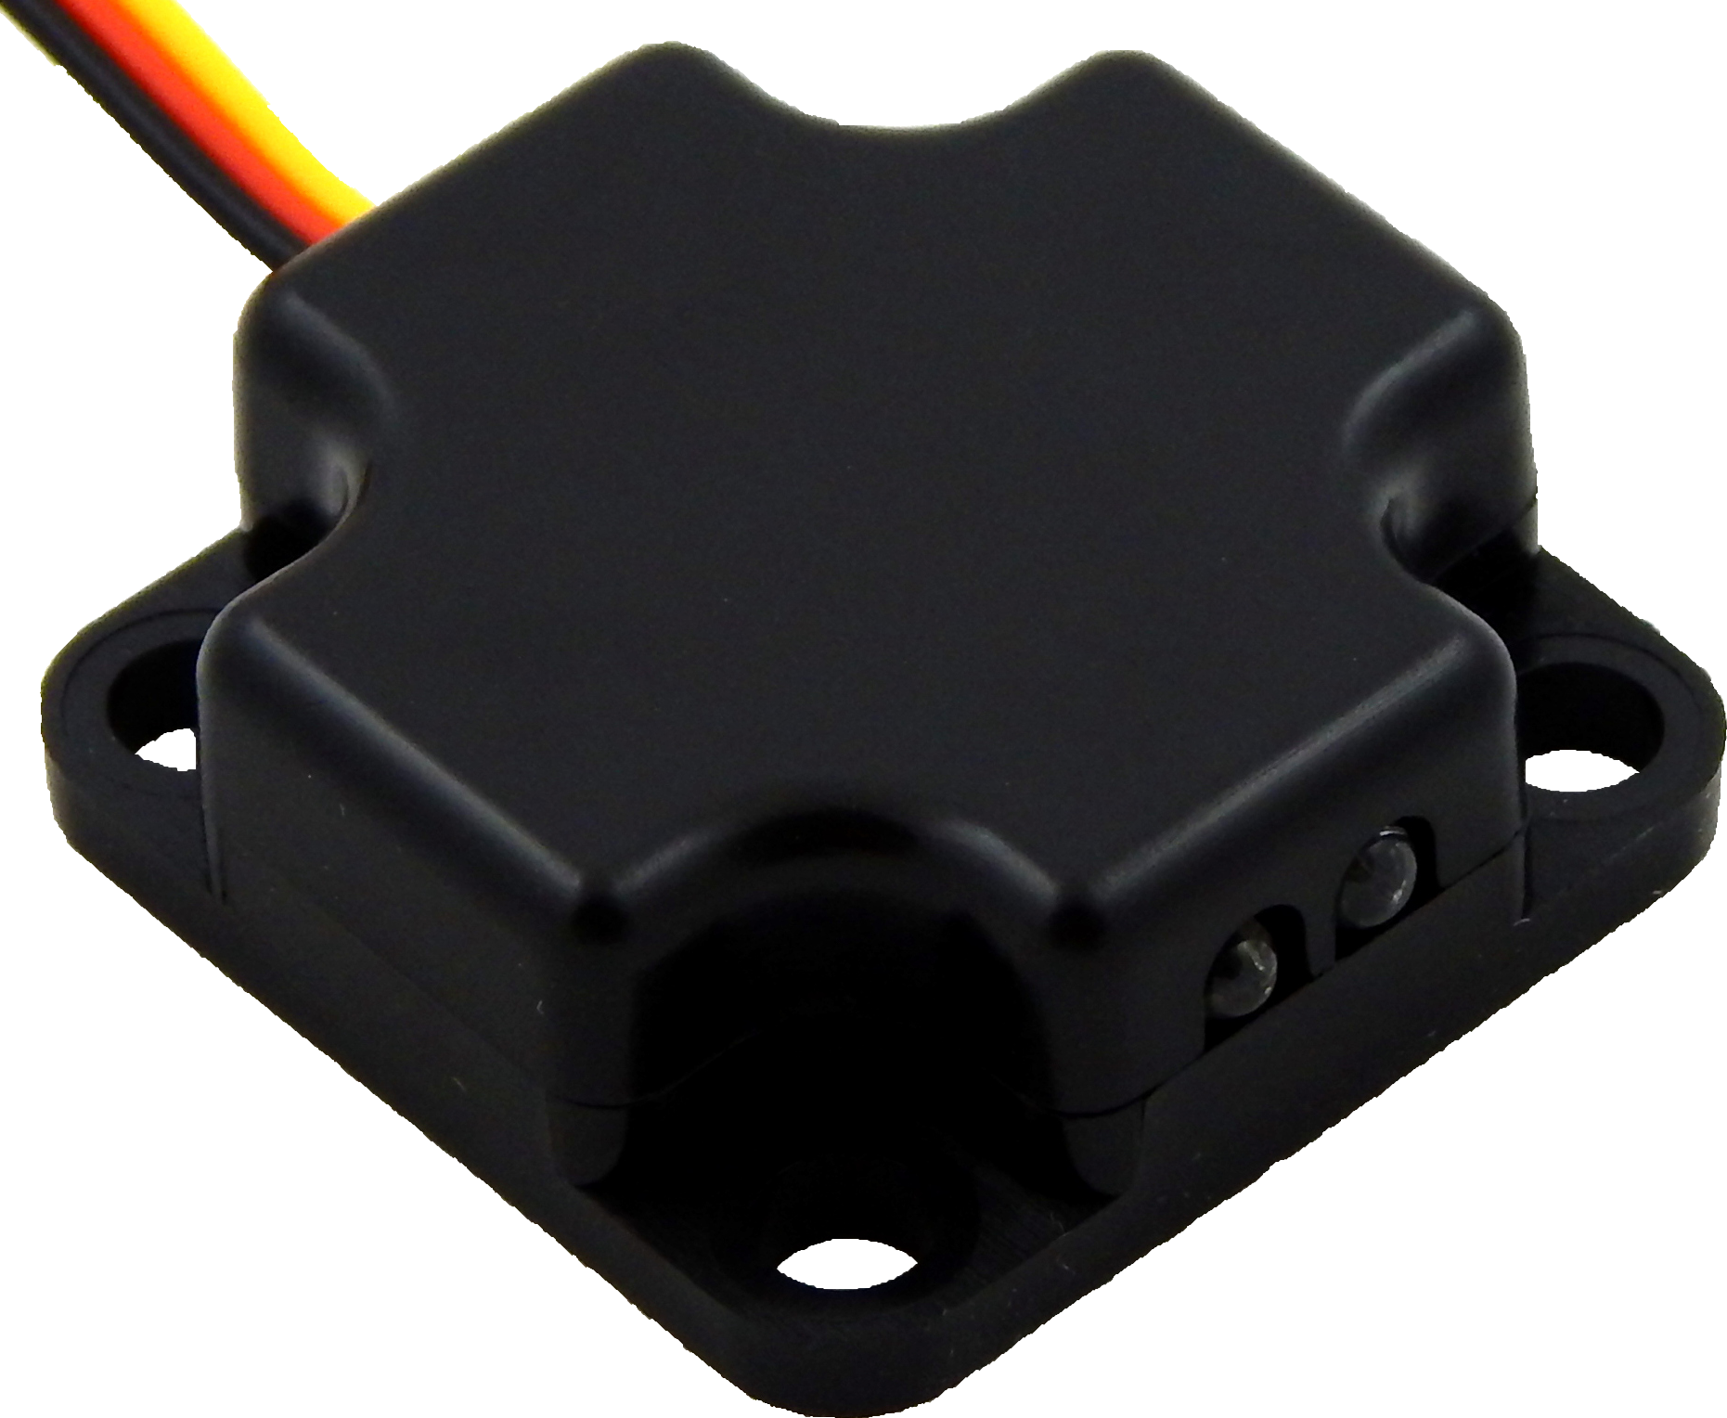
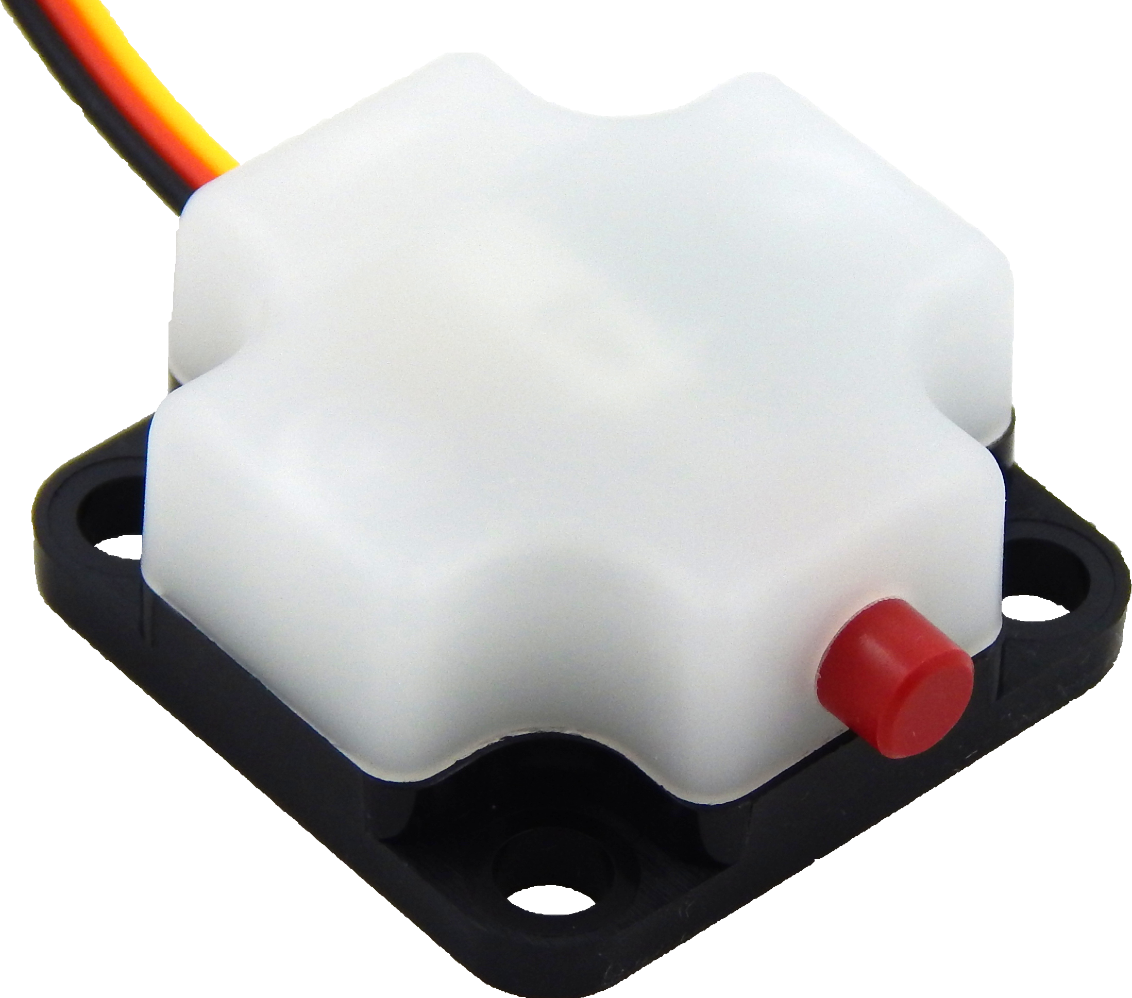
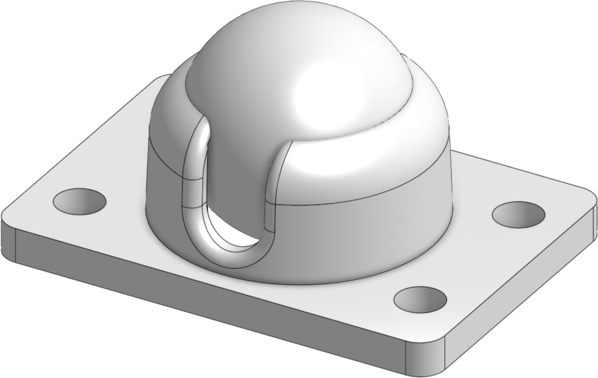
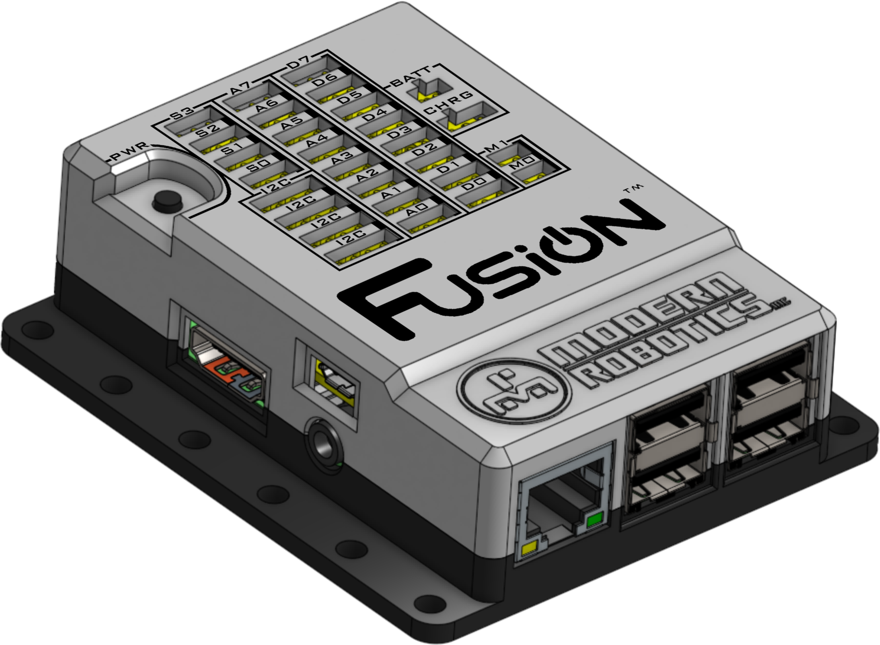
Bill of Materials
x1 45-2006 Optical Distance Sensor
x1 45-2007 Touch Sensor
x1 45-2100 19mm Ball Caster
x1 52-2022 Fusion Controller

Slide 5
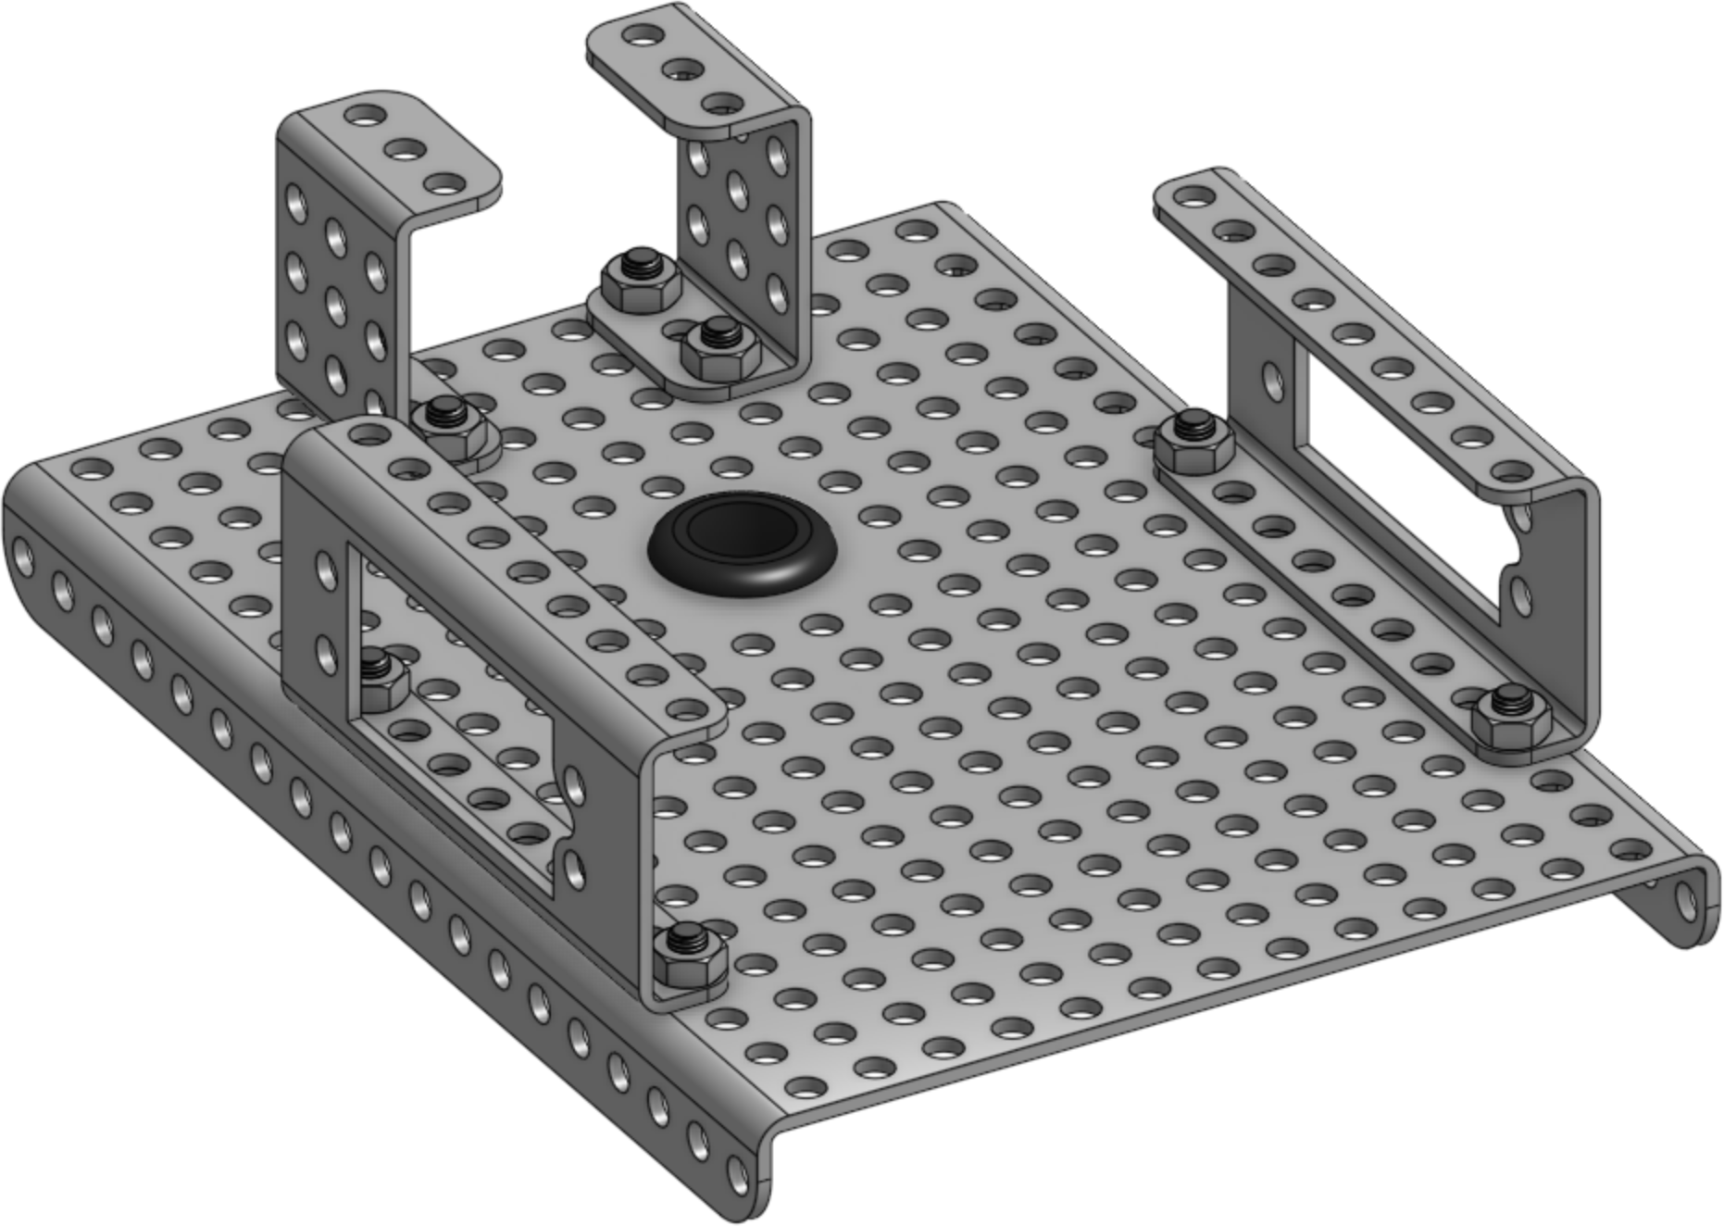
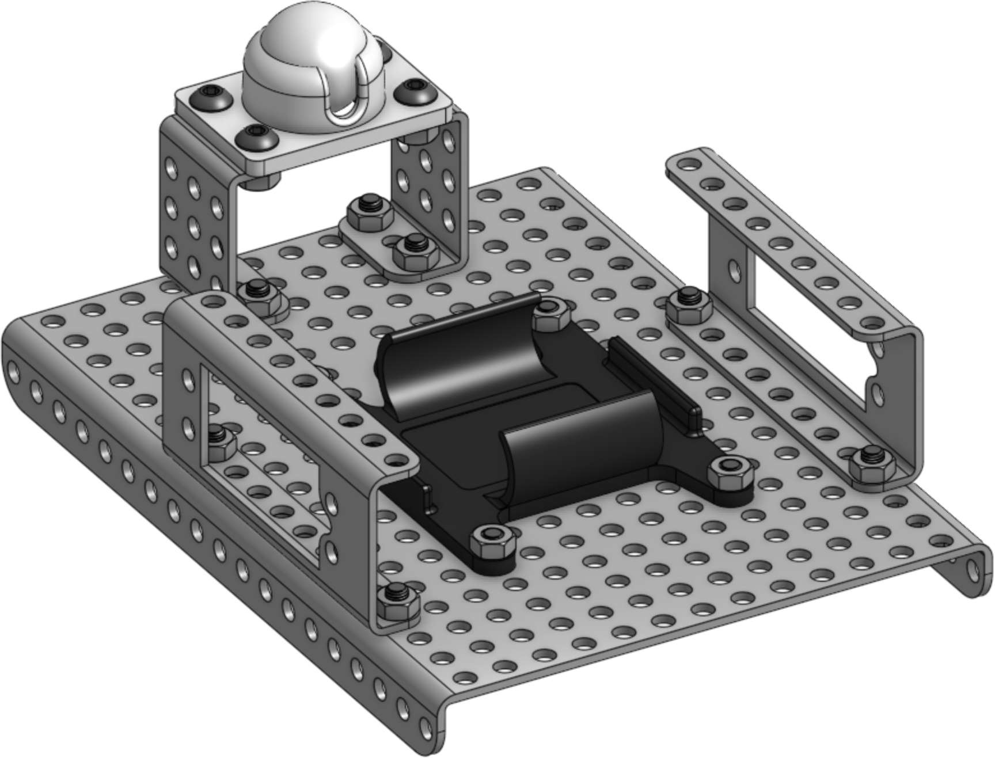
1
x1
x1
x2
x2
x8(8mm)
x8
2
x1
x8(8mm)
x1
x8

Slide 6
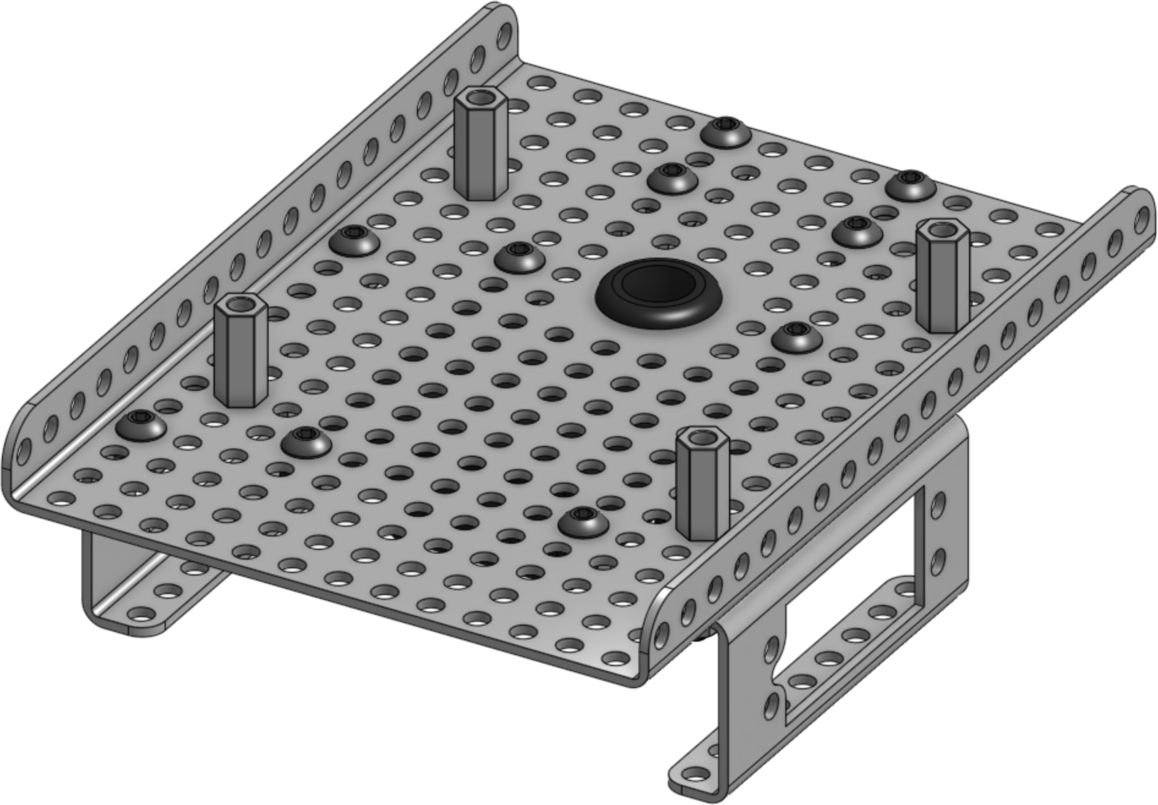
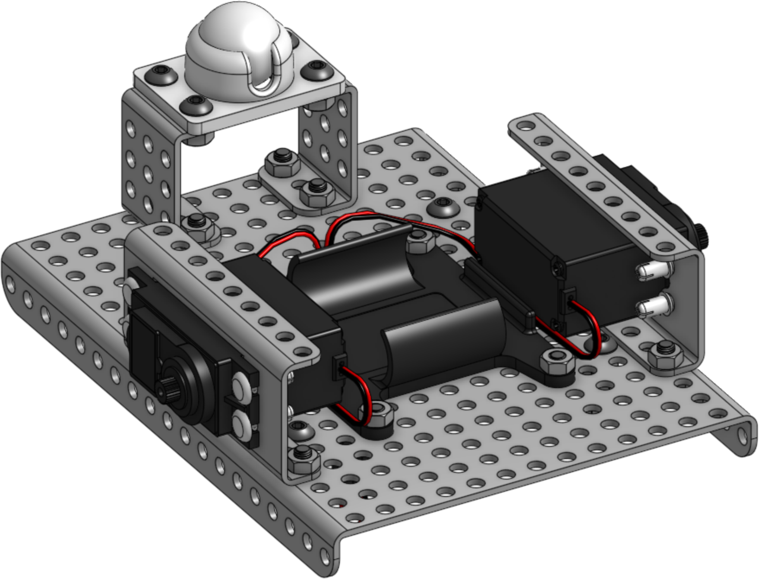
3
x4
x4(8mm)
4
x2
x8
M0
M1

Slide 7
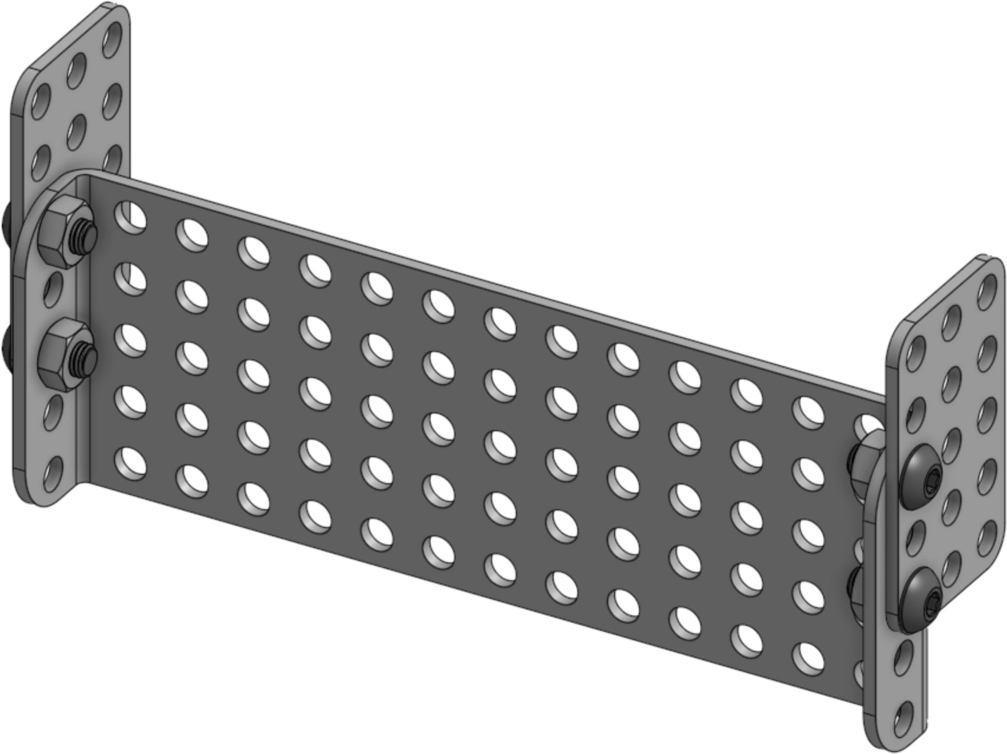
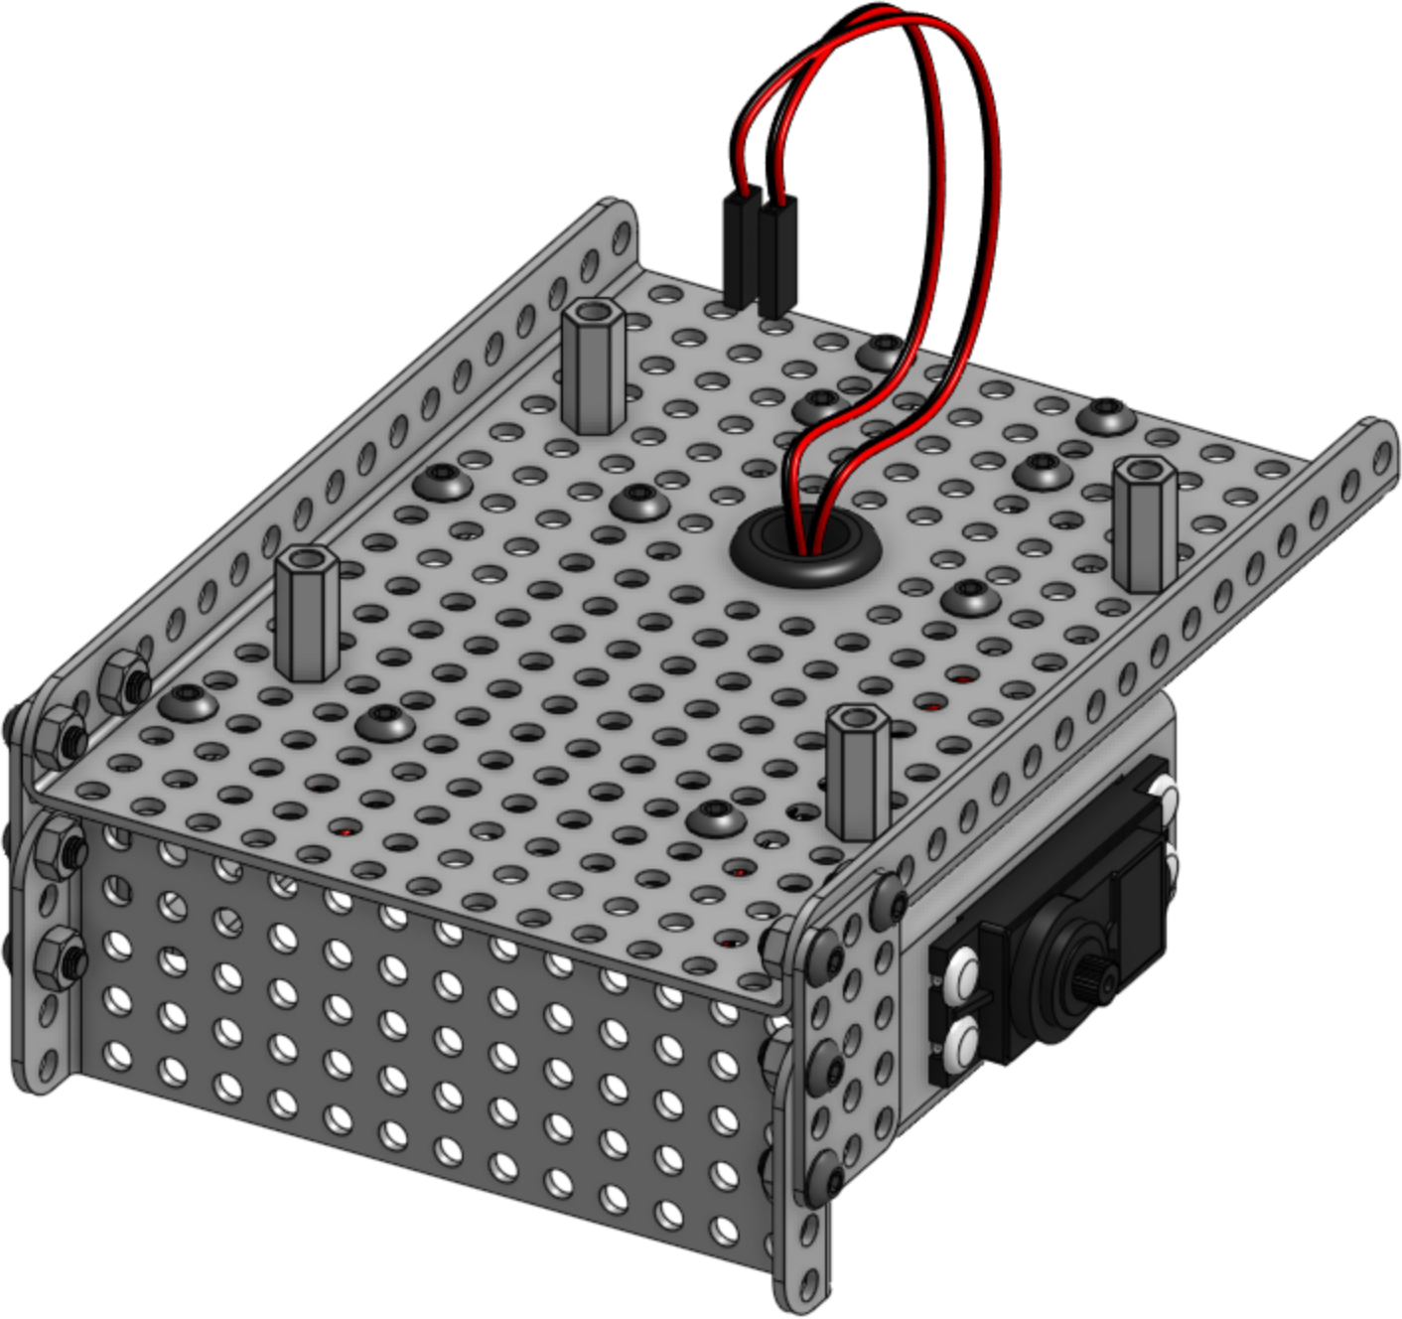
5
x1
x2
x4(8mm)
x4
6
x1
x4(8mm)
x4

Slide 8
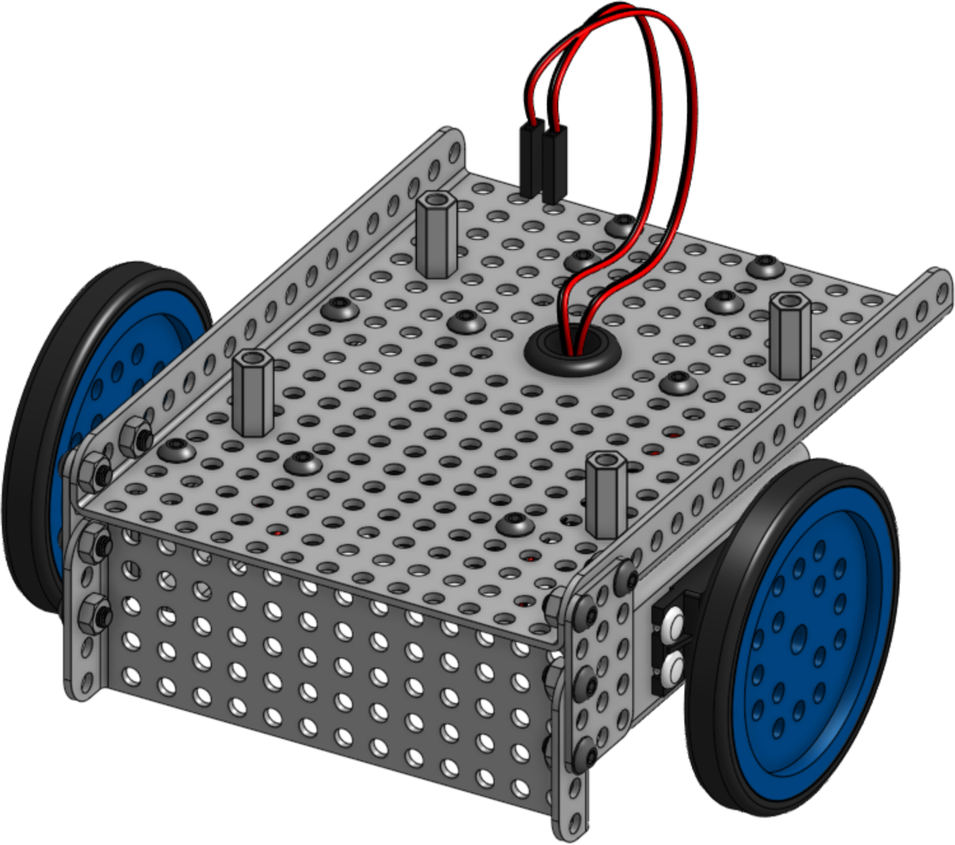
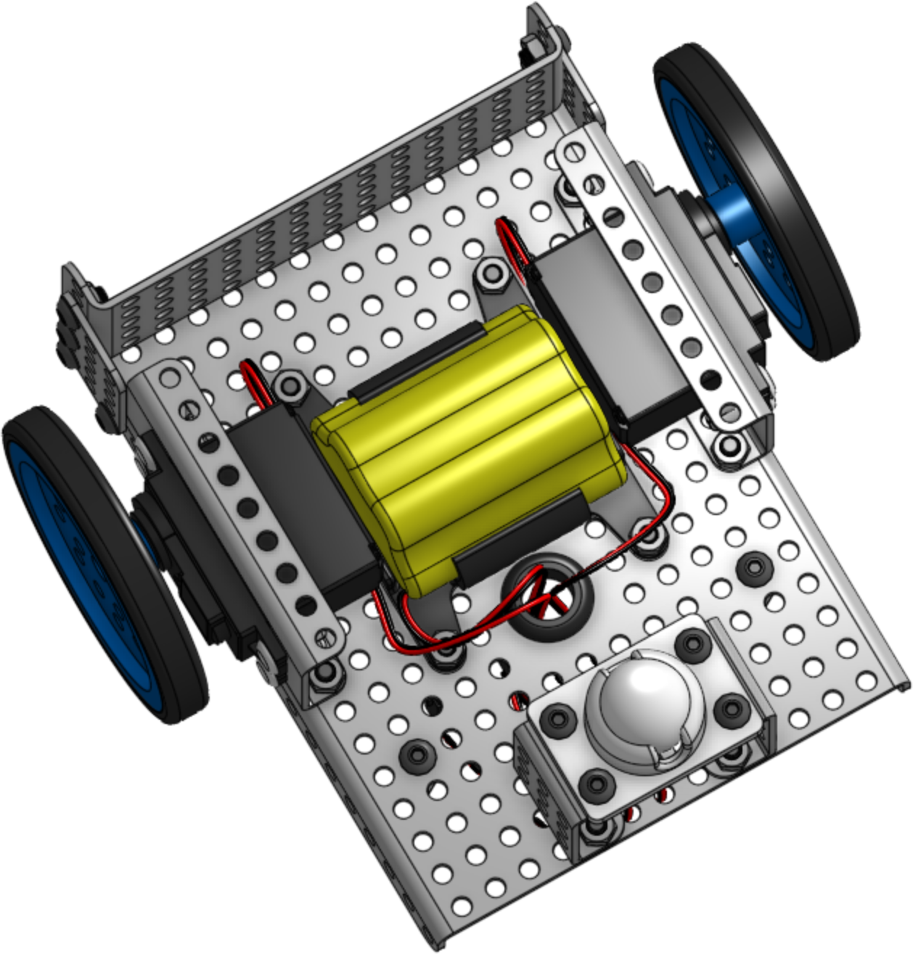
7
x2
x2
8
x1

Slide 9
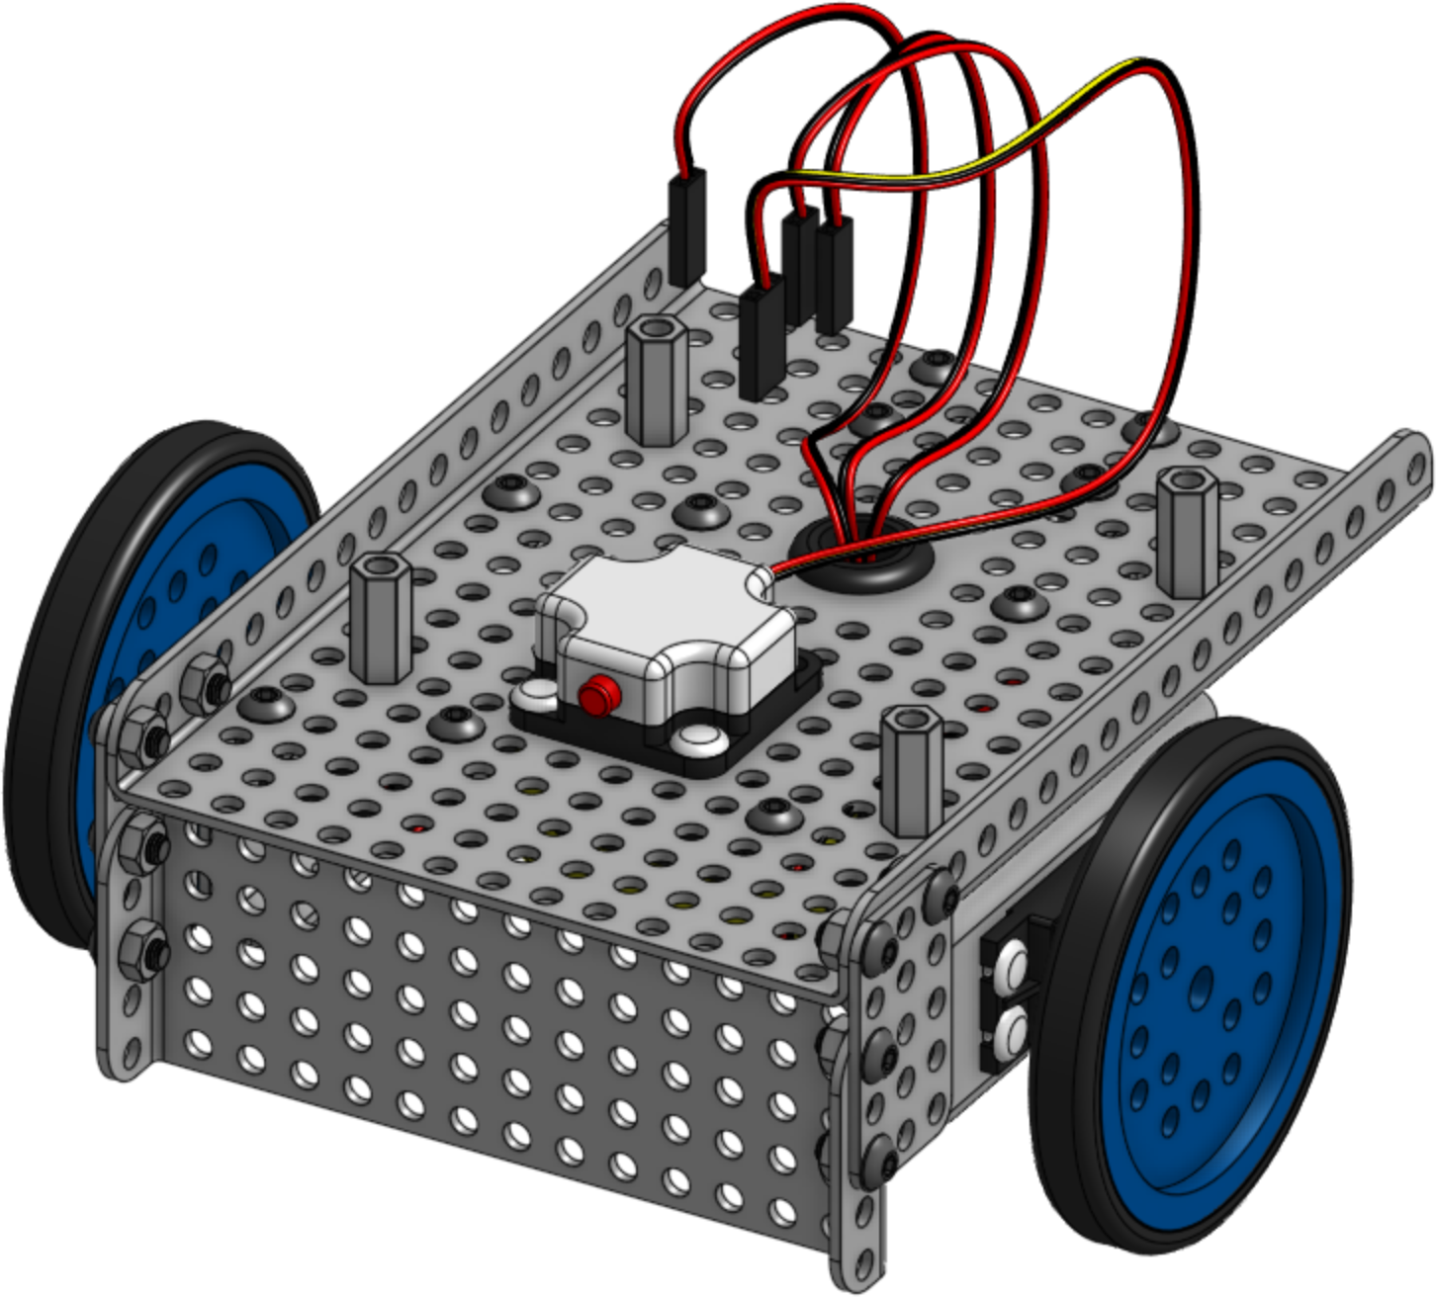
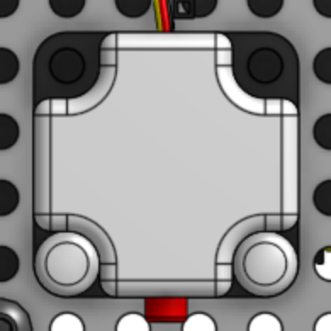
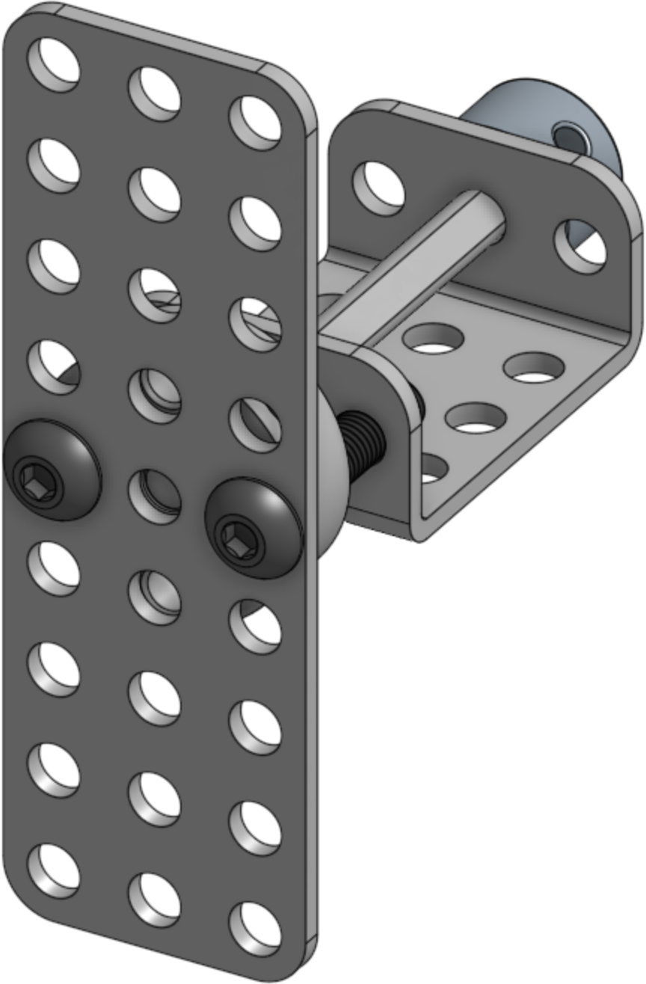
9
x1
x2
10
x1
x1
x1
x1
x1
x2(20mm)

Slide 10
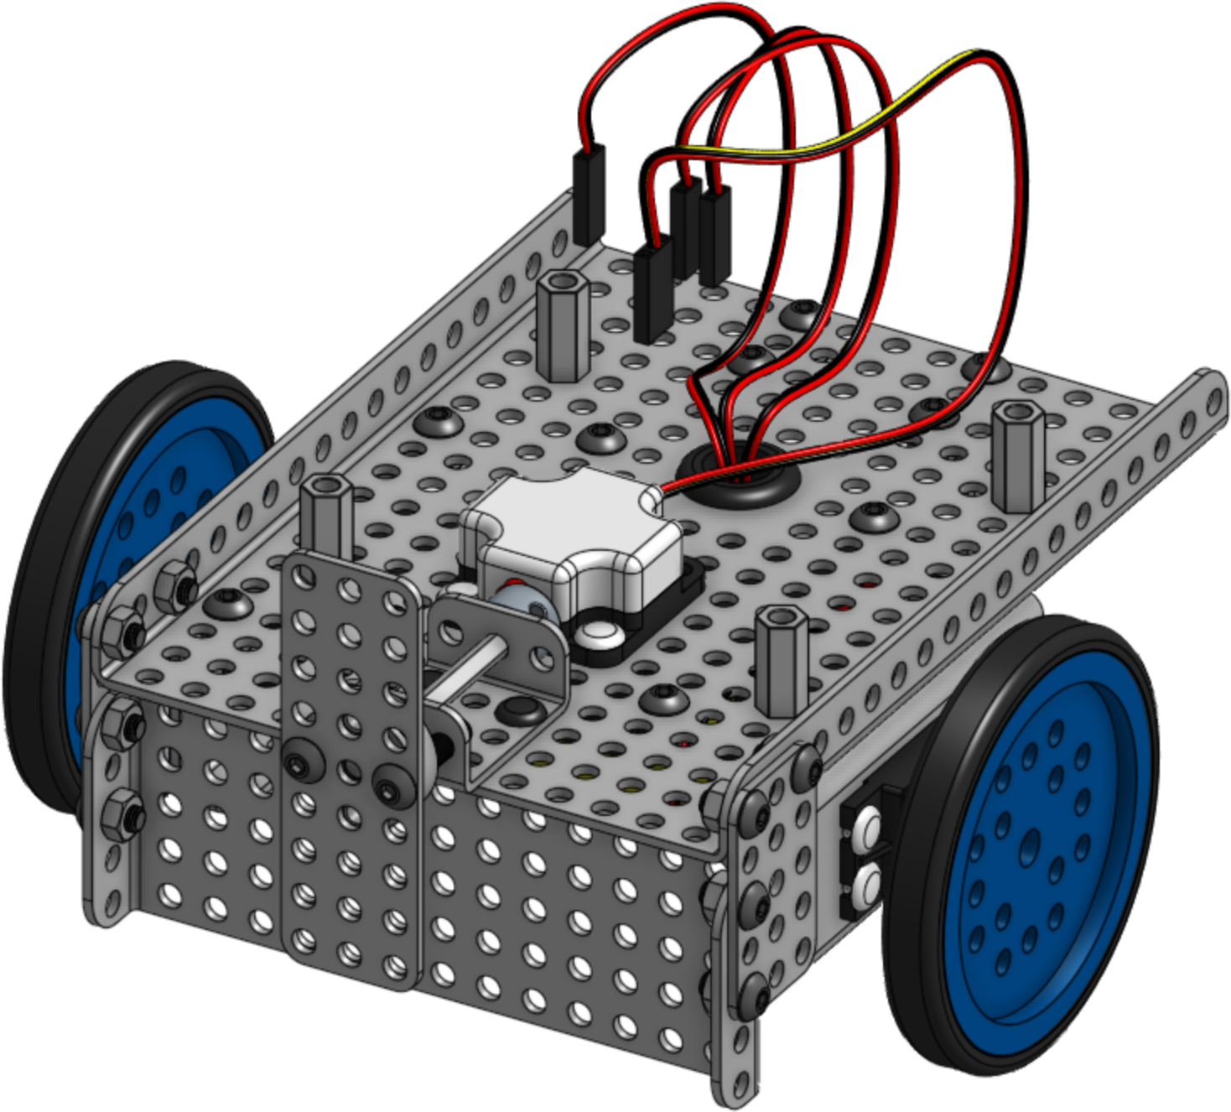
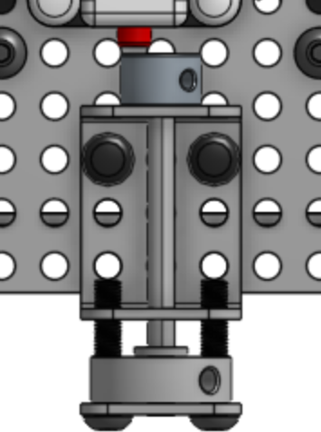
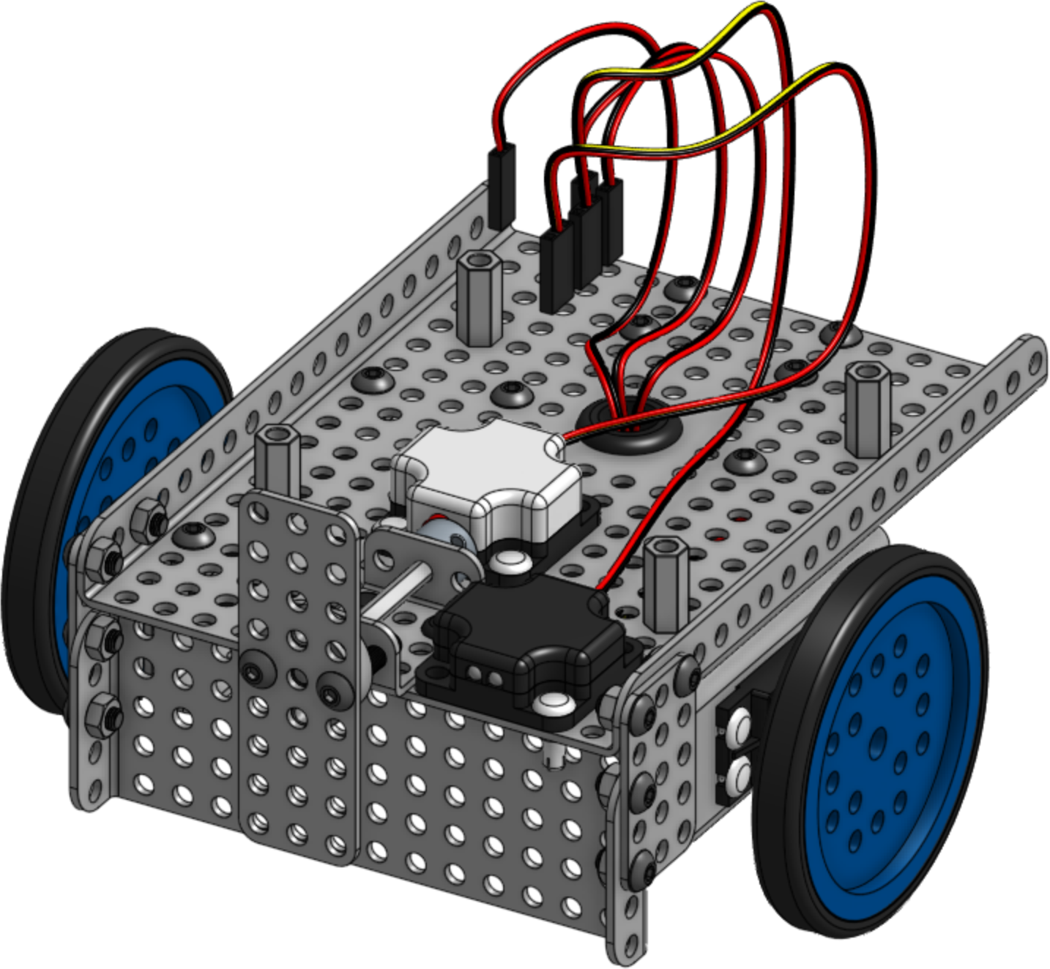
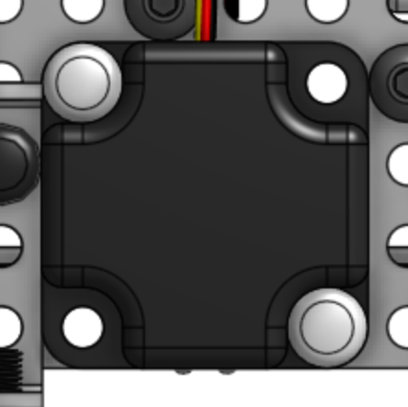
11
x1
x2
12
x1
x2

Slide 11
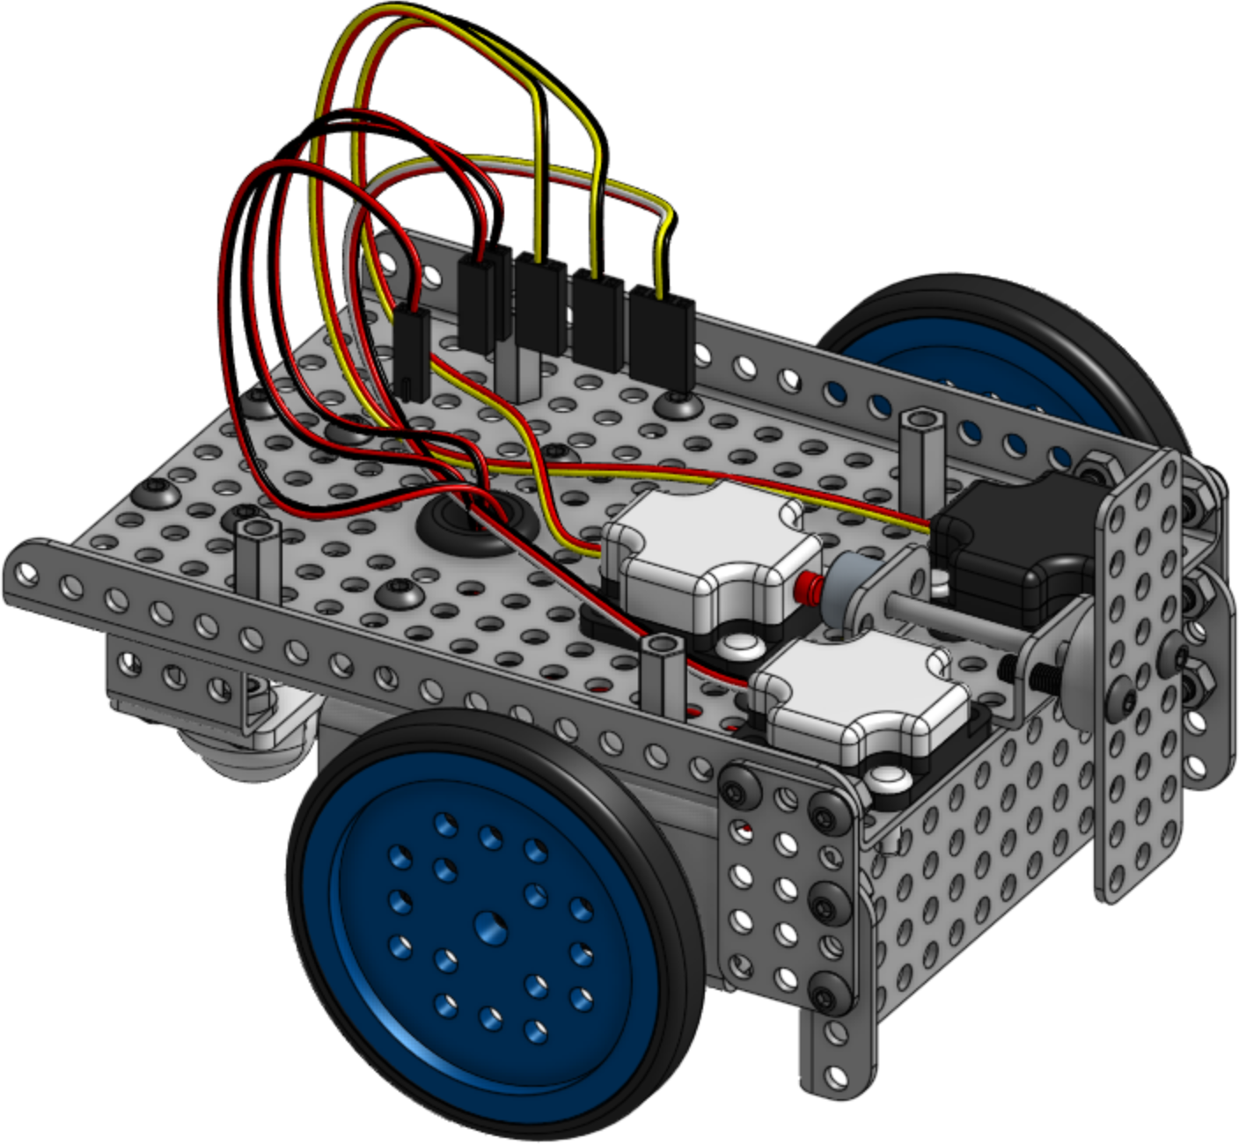
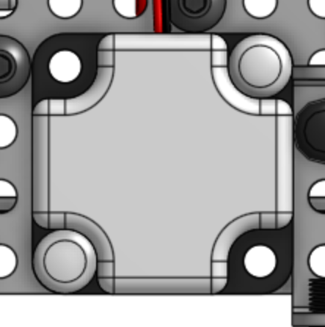
11
x1
x2
12
x1
x4(8mm)

Slide 12
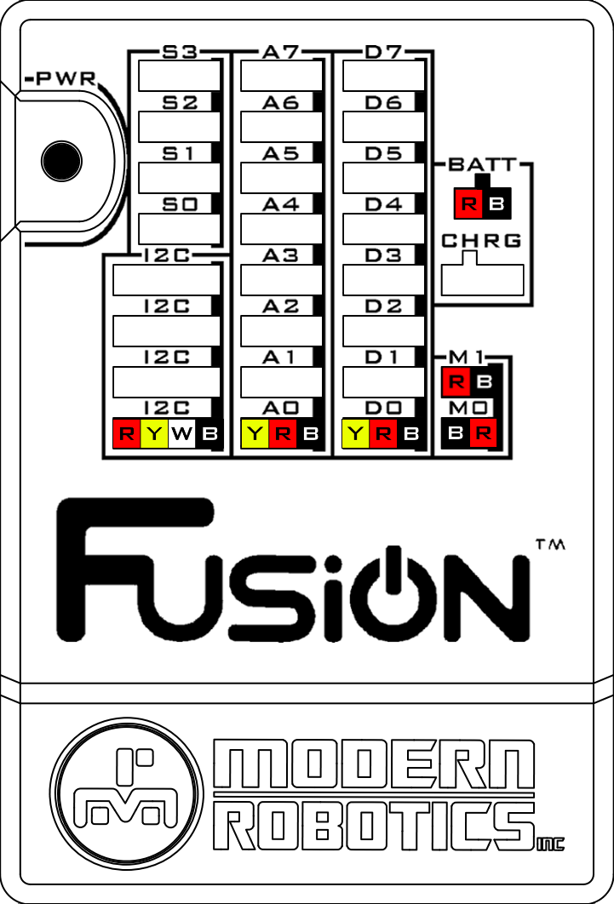
Optical Distance Sensor | → | A0
Touch Sensor | → | D0
Integrating Gyro | → | I2C
Right Motor | → | M0
Left Motor | → | M1
Battery | → | BATT
M0
M1

